Slide 1
Recitation7
李磊
2023/10/25

Slide 2
Announcements
11/06期中考试, 考到第六章, 大家合理安排复习
下周的回课是期中复习回课
Attacklab 10/26ddl
Archlab 10/31due, 11/02ddl, ddl后会安排同学回顾, 请大家积极报名

Slide 3
Schedule
张致,宋子青同学回课
助教回顾本周重点内容和相关往年题
讲流水线大题

Slide 4
Instruction | Fetch | Decode | Execute | Memory r/w | Writeback | PC update
cmovxx | ifun; rA; rB; valP=PC+2 | valA=R[rA] valB=0 | valE=valB+valA cnd=Cond(CC,ifun) |  | if(cnd): R[rB]=valE | PC=valP
irmov | rB; valC; valP=PC+10 |  | valE=0+valC |  | R[rB]=valE | PC=valP
rmmov | rA; rB; valC; valP=PC+10 | valA=R[rA] valB=R[rB] | valE=valB+valC | M₈[valE]=valA |  | PC=valP
mrmov | rA; rB; valC; valP=PC+10 | valB=R[rB] | valE=valB+valC | valM=M₈[valE] | R[rA]=valM | PC=valP
OP | ifun; rA; rB; valP=PC+2 | valA=R[rA] valB=R[rB] | valE=valA OP valB Set CC |  | R[rB]=valE | PC=valP
jxx | ifun; valC; valP=PC+9 |  | cnd=Cond(CC,ifun) |  |  | PC=cnd? valC : valP
call | valC; valP=PC+9 | valB=R[%rsp] | valE=valB+(-8) | M₈[valE]=valP | R[%rsp]=valE | PC=valC
ret |  | valA=R[%rsp] valB=R[%rsp] | valE=valB+8 | valM=M₈[valA] | R[%rsp]=valE | PC=valM
push | rA; valP=PC+2 | valA=R[rA] valB=R[%rsp] | valE=valB+(-8) | M₈[valE]=valA | R[%rsp]=valE | PC=valP
pop | rA; valP=PC+2 | valA=R[%rsp] valB=R[%rsp] | valE=valB+8 | valM=M₈[valA] | R[%rsp]=valE R[rA]=valM | PC=valP

Slide 5
Points worth noting
Remember what each state does!
Remember the meaning of rA, rB, valA, valB, valC, valE, valM
Note the order of some instruction (think of: push %rsp & pop %rsp)
Use 'cond,' 'cnd,' and 'CC' in the correct format

Slide 6
Examples (2020)
icode:ifun <- M1[PC]
valP <- PC + 1
valA <- R[%rbp]
valB <- R[%rbp]
valE <- valB + 8
valM <- M8[valA]
R[%rsp] <- ValE
R[%rbp] <- ValM

Slide 7
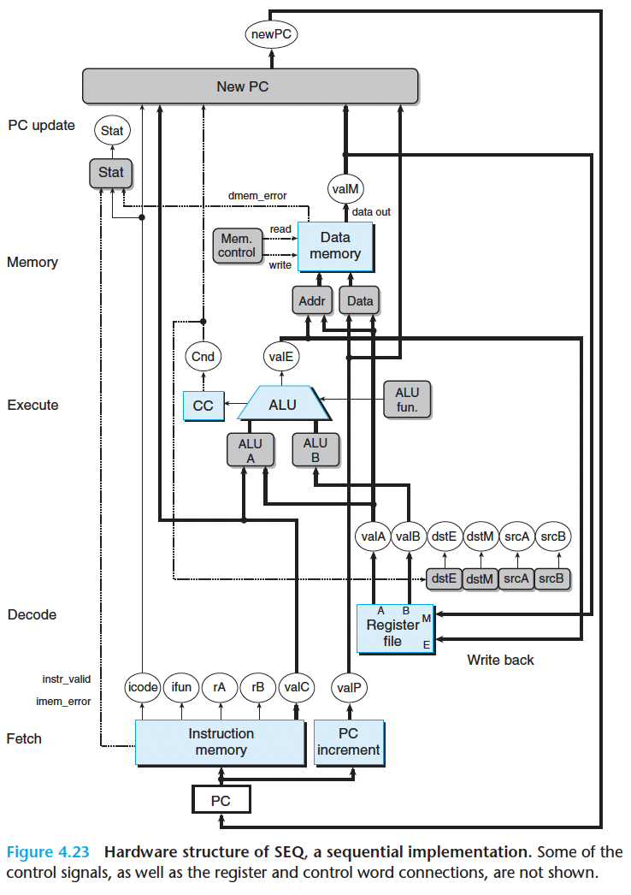
Hardware structure
Notice the color of different units
Blue, gray and white
Five stages
Note the relationship between datapath & control logic
HCL only describes the control logic

Slide 8
Combinational Circuit & Sequential Circuit
Combinational Circuit
does not require any sequencing or control
values propagate through a network of logic gates whenever the inputs change
Sequential Circuit
controlled via a single clock signal
Triggered by a clock transition

Slide 9
Example
Combinational Circuit or Sequential Circuit?
Register files?
Data memory?
ALU?
CC?
Instruction memory?
PC?

Slide 10
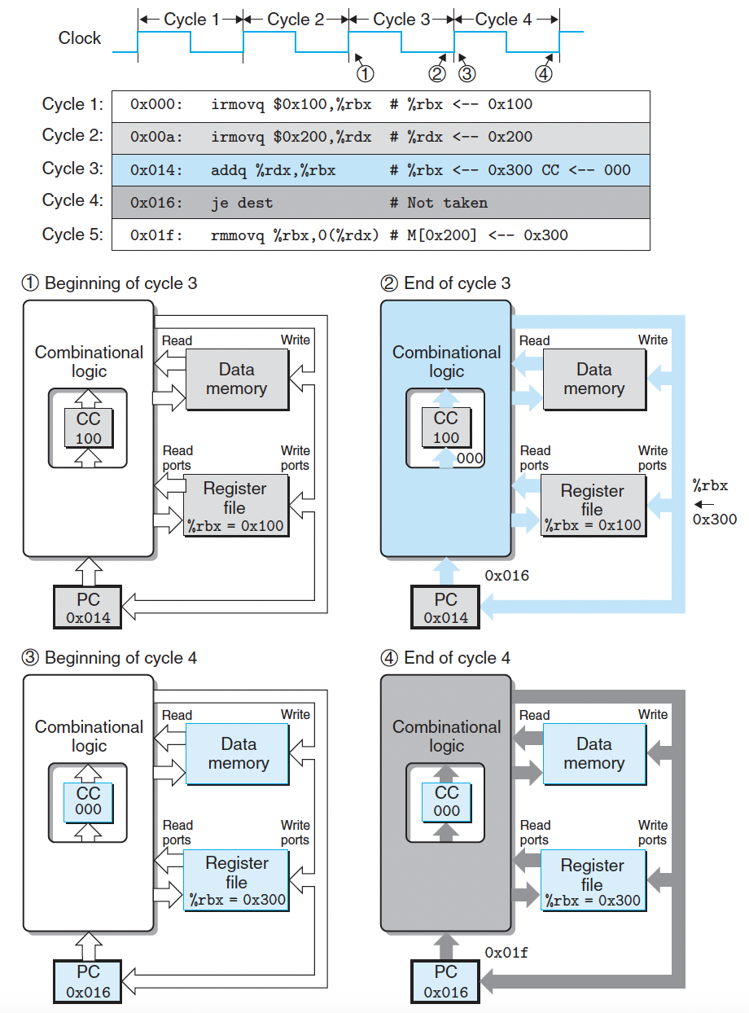
Example
State are updated as clock rises
CC
DMEM
Register file
PC
The outputs of combinational logic just change as their inputs change
ALU
Memory reads

Slide 11
Make it better?
One clock cycle take too long time;
Most parts of the processor are idle at most time in one cycle;

Slide 12
Parallelism
Parallelism is one of the greatest ideas in computer architecture.
Parallel threads
Parallel data
Parallel instructions
More than one instruction at one time

Slide 13
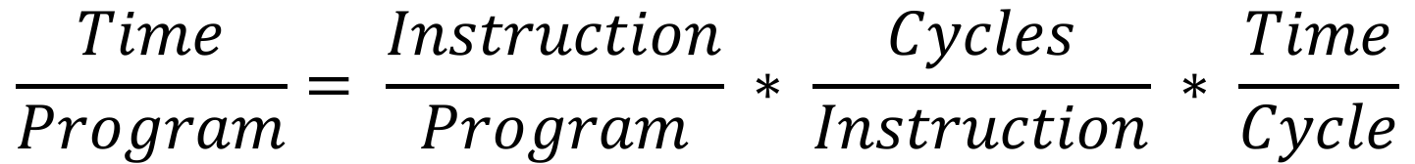
Law of performance
$$\frac{Time}{Program}= \frac{Instruction}{Program} ∗ \frac{Cycles}{Instruction} ∗ \frac{Time}{Cycle}$$
CPI = Cycles Per Instruction

Slide 14
Instructions per Program
Determined by
Algorithm
Compiler
ISA

Slide 15
Clock Cycles per Instruction (CPI)
Determined by
ISA - Processor implementation
E.g. for our single-cycle Y86 design, CPI = 1
For our pipeline Y86 design, CPI > 1
Superscalar processors, CPI < 1 (we have IPC in this case)

Slide 16
Time per Cycle
Determined by
Processor microarchitecture (determines critical path through logic gates)
Power budget (lower voltages reduce transistor speed)

Slide 17
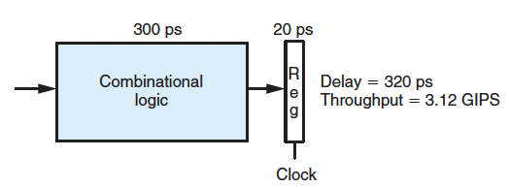
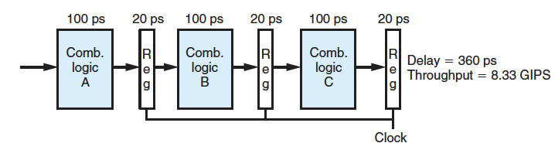
Pipeline - philosophy
Need pipeline registers to store the states
Higher throughput
Higher delay

Slide 18
Problems - Nonuniform Partitioning
50 ps
20 ps
150 ps
20 ps
100 ps
20 ps
Comb.
logic
A
R
e
g
Comb.
logic
B
R
e
g
Comb.
logic
C
R
e
g
OP1
A
B
C
OP2
A
B
C
OP3
A
B
C
Time
Clock
50 ps
20 ps
50 ps
20 ps
50 ps
20 ps
50 ps
20 ps
50 ps
20 ps
50 ps
20 ps
Comb.
logic
R
e
g
Comb.
logic
R
e
g
Comb.
logic
R
e
g
Comb.
logic
R
e
g
Comb.
logic
R
e
g
Comb.
logic
R
e
g
Clock

Slide 19
Problem - Hazards
A hazard is a situation that prevents starting the next instruction in the next clock cycle
1)Structural hazard
A required resource is busy(e.g. needed in multiple stages)
No structural hazard in CSAPP
2)Data hazard
Data dependency between instructions
Need to wait for previous instruction to complete its data read/write
3)Control hazard
Flow of execution depends on previous instruction
All hazards can be solved by stalling.

Slide 20
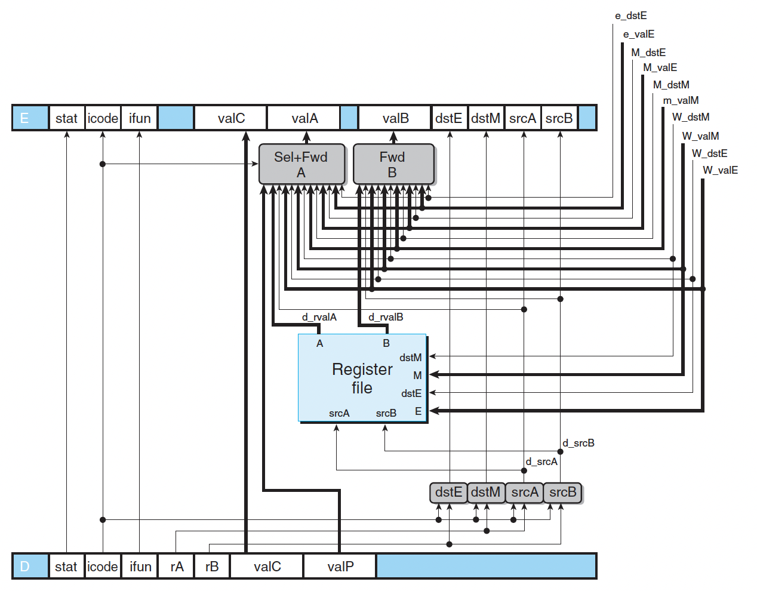
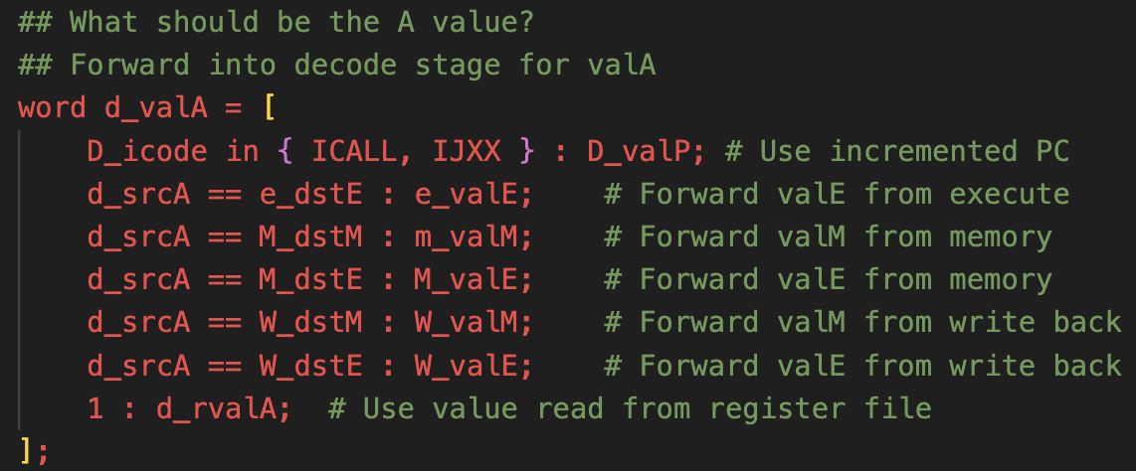
Solution – data hazard
Forwarding
Always forward to decode stage
Note the precedence of data forwarding (e > M > W) (M > E)
cannot resolve load & use sometimes

Slide 21
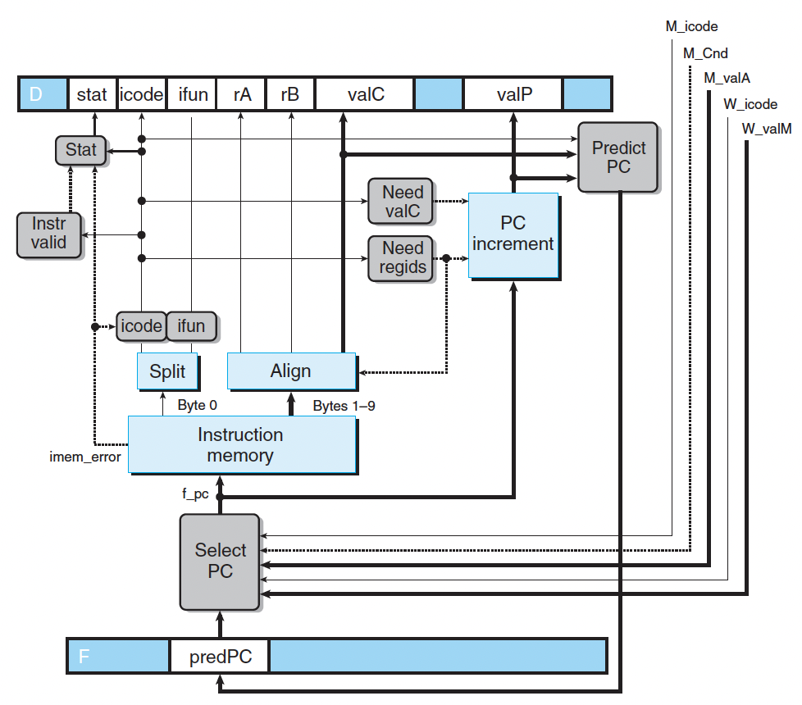
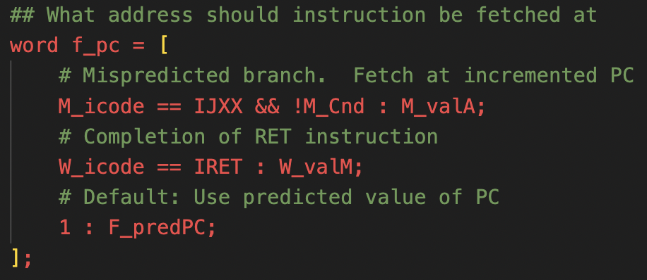
Solution – control hazard
For ret, just stall for 3 cycles
More complex architectures have better methods to avoid stalls caused by 'ret' instructions.
For conditional jump, we can predict whether or not we will take the branch
Misprediction must be dealt with.

Slide 22
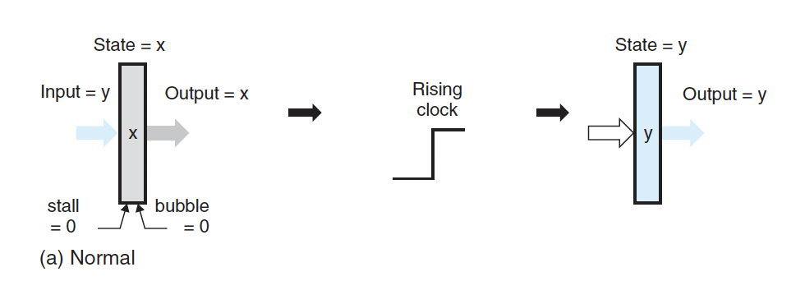
How can we just stop the pipeline?
By controlling the signals of the pipeline registers!

Slide 23
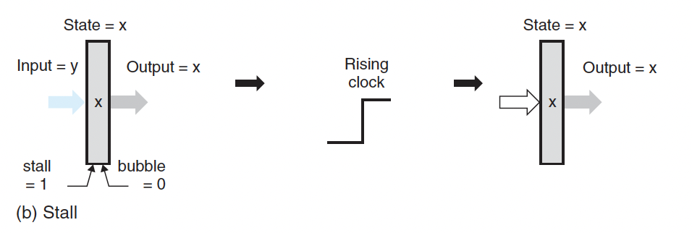
How can we just stop the pipeline?
By controlling the signals of the pipeline registers!

Slide 24
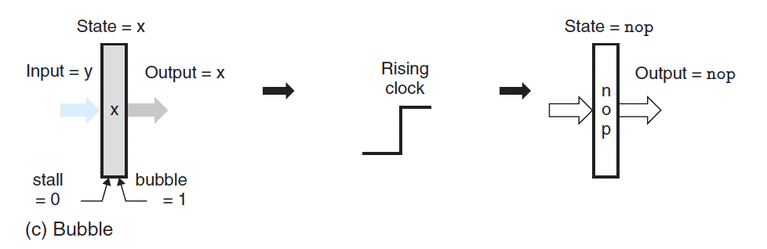
How can we just stop the pipeline?
By controlling the signals of the pipeline registers!

Slide 25
How to understand the hcl?
HCL describes the logic of gray block in the pipeline.
You can try to combine HCL and the pipeline to understand them better.
Useful tip: try to write your own hcl in your archlab, this will deepen your understanding.
I will give just one example, read the rest by yourself!

Slide 26
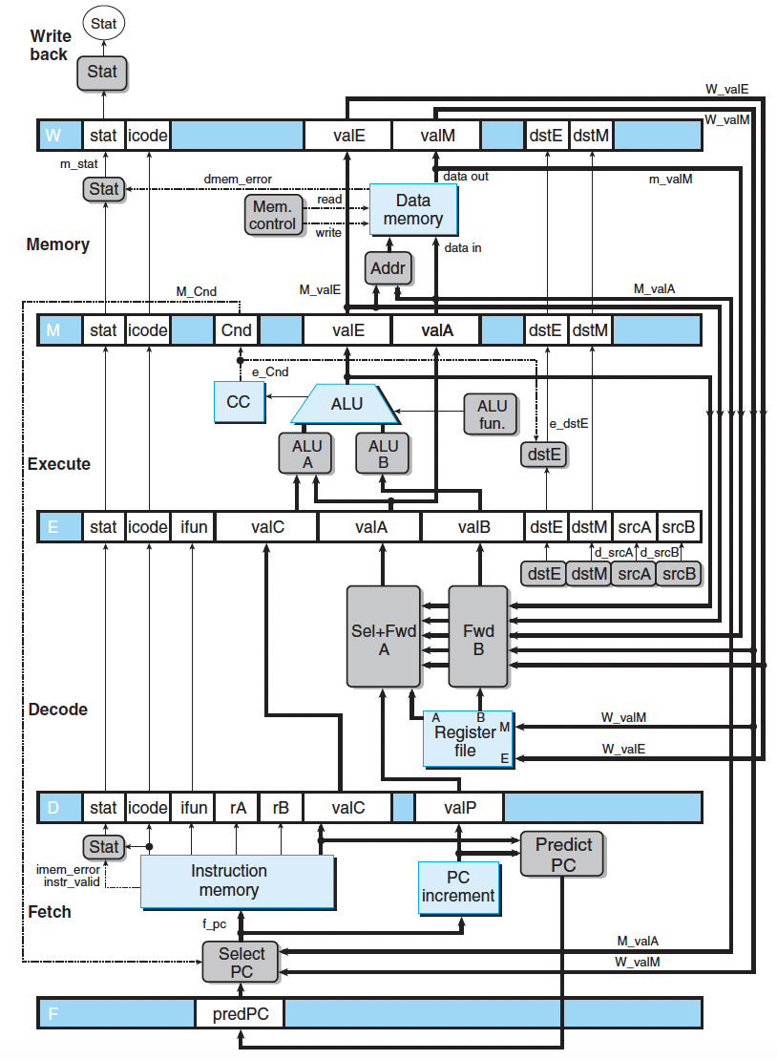
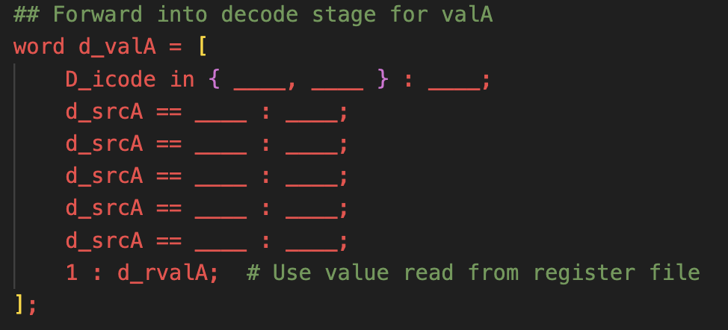

Slide 27
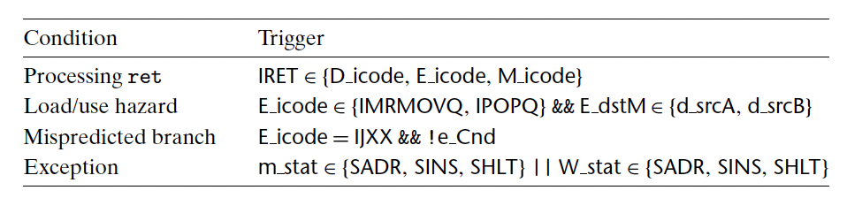
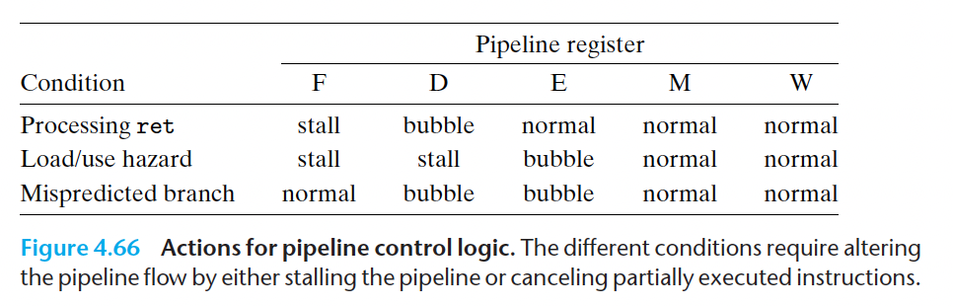
Hazard – control logic
We need a control logic the determine whether there is a hazard.
And if there is, we need some control logics for the pipeline registers to deal with the hazard.
I will also give an example, try out the rest by yourself!

Slide 28
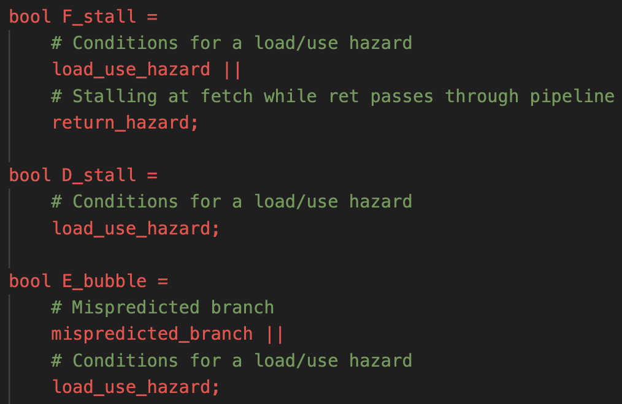
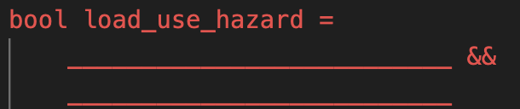

Slide 29
Combinations:
ret + misprediction (ret is not executed, and is replaced by a bubble):
when detected: give F stall and D/E bubble
cannot both give F stall and give F bubble
ret + load/use (when the register loaded/used is %rsp; ret is executed):
when detected: give F/D stall and E bubble

Slide 30
Exceptions
We store a stat bit in all pipeline registers
Several subtleties
Multiple exceptions -- the first exception is the most significant
Mispredicted branch – ignore the exception
If an invalid instruction reaches the memory stage, then the machine is going to stop.
prevents following instructions from updating CC and other programmer visible states

Slide 31
Examples
D

Slide 32
Examples
C

Slide 33
Examples

Slide 34
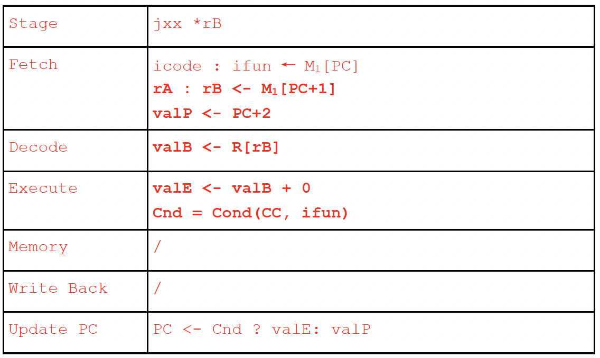
Examples

Slide 35
Examples
不需要

Slide 36
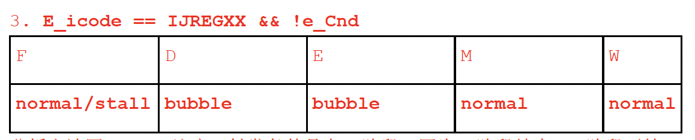
Examples
D_icode == IJREGXX: d_valB;
1 2 3

Slide 37
15 13 20

